Slide 1

Secdrop- Secure Encrypted File Sharing Platform
Team Members:
Dilpreet Sidhu
Gurpreet Kaur
Priyanshu
Jenil Chaklasiya

Slide 2
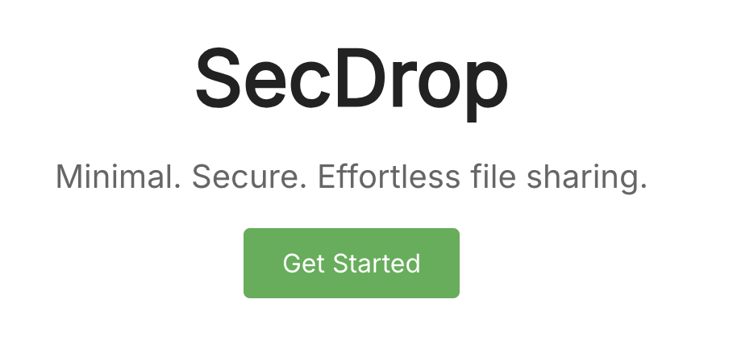
Problem Definition
Existing platforms such as Drobox, google Drive doesn’t follow "privacy by default"
Often require account creation, complicating usability
Need: free, anonymous, secure, encrypted file sharing platform with ease-of-use.
Solution: Secdrop with AES-256 encryption, password protection, and token-based access

Slide 3
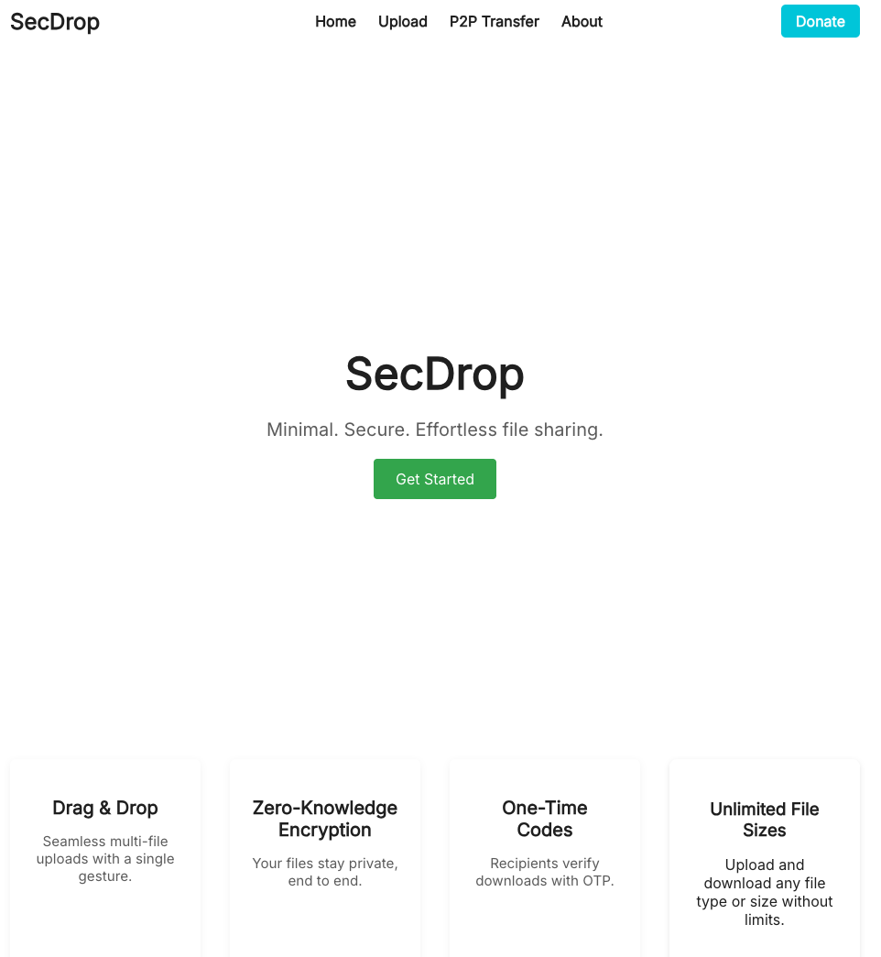
Application Benefits
Anonymous Sharing: no account or personal info required
Built-in E2E Encryption: AES-256-GCM on every upload/download
Password & OTP Protection: 7-digit code + one-time code deliveries via email
Free Admin Controls (future): size limits, expirations, manual deletes

Slide 4
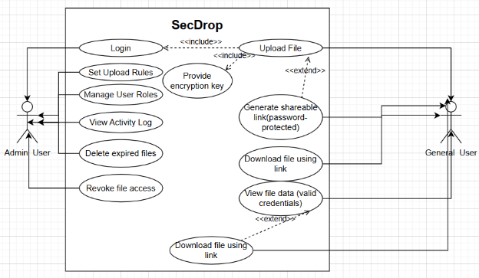
USE CASE DIAGRAM
Functional Requirement of Admin User:
Set upload rules (size, expiry)
Delete files (manually/automatically)
Monitor logs (uploads/downloads/share links)

Slide 5
USE CASE DIAGRAM
Functional Requirement of General User:
Upload file (AES-256 encrypted)
Generate password-protected link
Download file (with authentication)
Receive error feedback

Slide 6
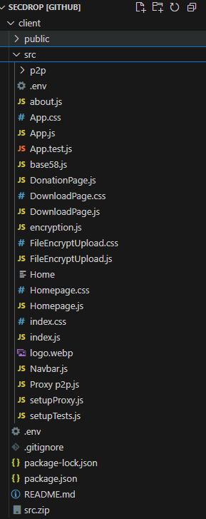
Software Architecture - Three-Layer Design
Presentation Layer (Frontend)-(HTML/CSS/JS)
User-facing layer of the software which is responsible for a smooth user interface. It is responsible for handling the UI components:
-Uploading and downloading the files
-Entering passwords or tokens
-Displaying error feedback or confirmations of the operations
-Provides secure communications with backend via API calls

Slide 7
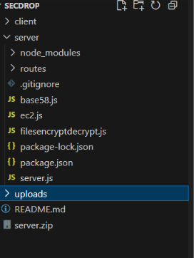
Software Architecture - Three-Layer Design
Business Logic Layer: Encryption, password validation (Node.js)
It handles the logic and processing of key operations. It is implemented using Express.js framework and is responsible for:
File encryption and decryption (AES-256-GCM)
Password and token validation
Secure file upload
Download routing
Logging activities such as link generations, uploads, downloads
Generating shareable links and applying expiration rules

Slide 8
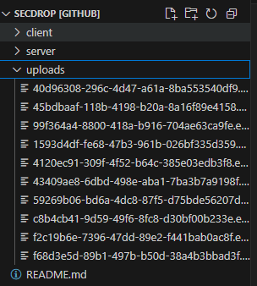
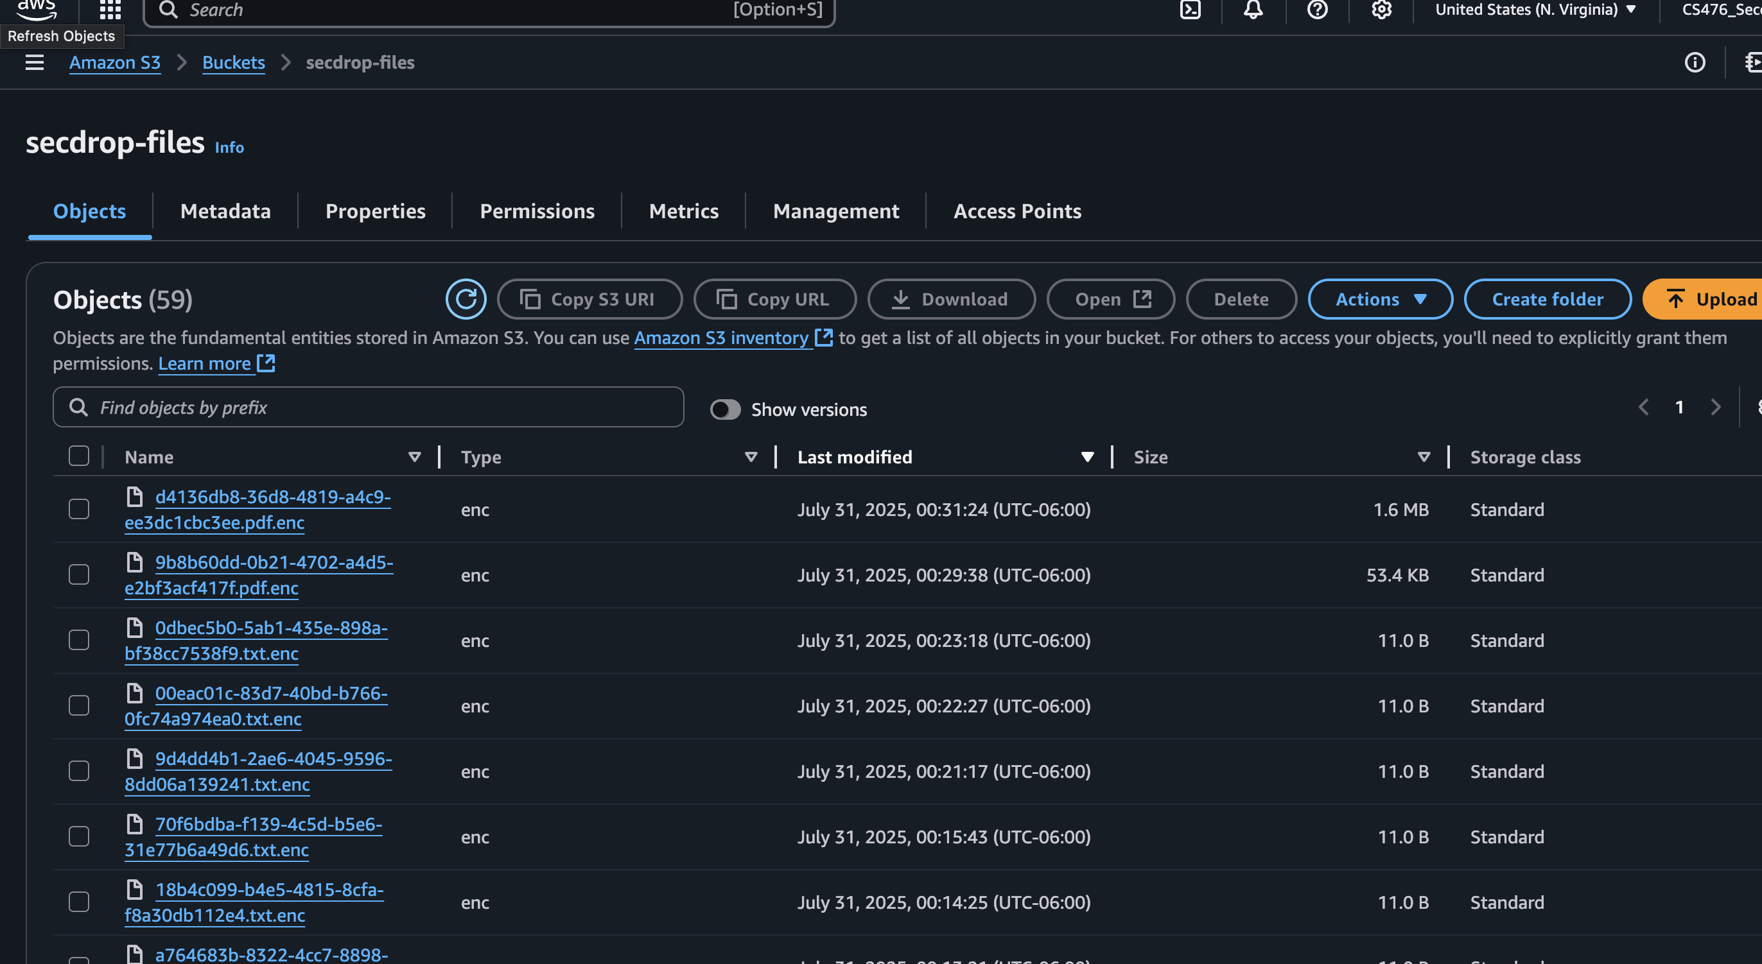
Software Architecture - Three-Layer Design
Data Layer: File storage, metadata (AWS S3)
The data layer is responsible for the secure storage of files and retrieval of information (metadata) as required. It has the following components:
- Storage of encrypted files via cloud storage services (Amazon S3)
- Storage of metadata such as file names, authentication tags, and optional passwords
- Controls the mechanism of expiration and deletion of files as requested by the user

Slide 9
Benefits of Three-Layer Design
Separation of concerns
Reusability
Scalability
Maintains robust and secure logic flow
Minimize the risk of exposing sensitive information

Slide 10
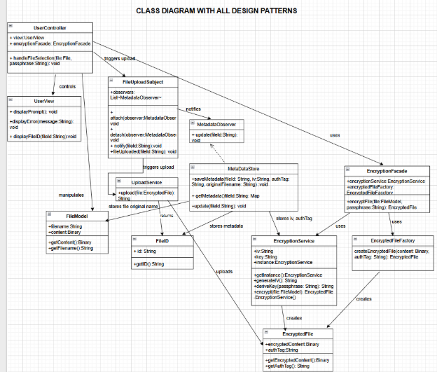
Design Patterns
Design Patterns helps to enhances the reusability of code
The design pattern used in the project:
Facade
Factory
Singleton

Slide 11
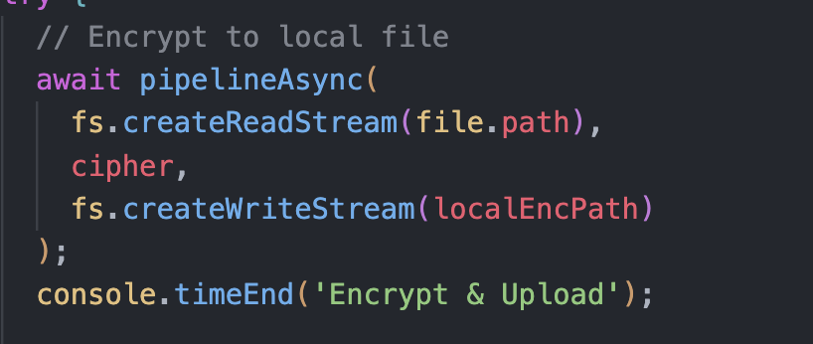
Facade Pattern
Provide a simple interface over a complex subsystem
Two “facade” methods in server/filesencryptdecrypt.js:
uploadFile(req,res)
downloadFile(req,res)
Hide all of:
PBKDF2 key derivation
AES-GCM cipher setup
Stream pipeline (encryption/decryption)
S3 upload/download
Email/SMS notifications
.

Slide 12
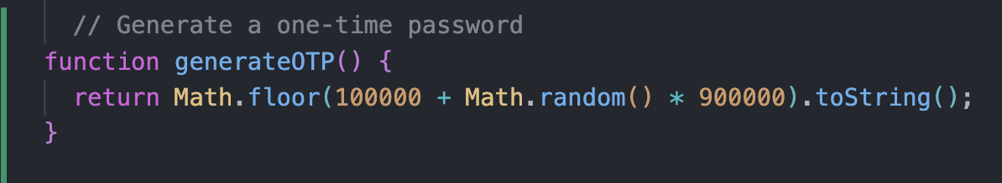
Factory Pattern
Encapsulate object/token creation behind a simple API.
Our Implementation generateOTP() for one-time codes crypto.randomUUID() for unique file IDs
Location Helpers at the top of server/filesencryptdecrypt.js
Centralizes randomness/format logic;
you “ask” the factory for a new token or ID without worrying how it’s made.

Slide 13
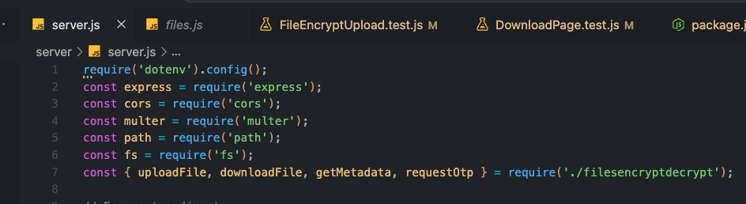
Singleton Pattern
The Singleton pattern ensures that a class or module has exactly one instance throughout the application and provides a global point of access to it.
New file server/server.js loads .env once and exports all settings.
Consistency: All parts of the app use the exact same SALT, URLs, bucket names, API keys.
Simplicity: No repeated process.env lookups or mismatched values.
Testability: Swap in mock configs during testing by pointing NODE_PATH or using module stubs.

Slide 14
What We’ve Built
Drag-&-drop multi-file uploads in React, protected by a 7-digit passphrase
End-to-End Encryption • Client-side AES-256-GCM + PBKDF2 key derivation; server-side decryption on download
One-Time Code Verification
Download Links & QR Codes
Scalable, Modular Backend

Slide 15
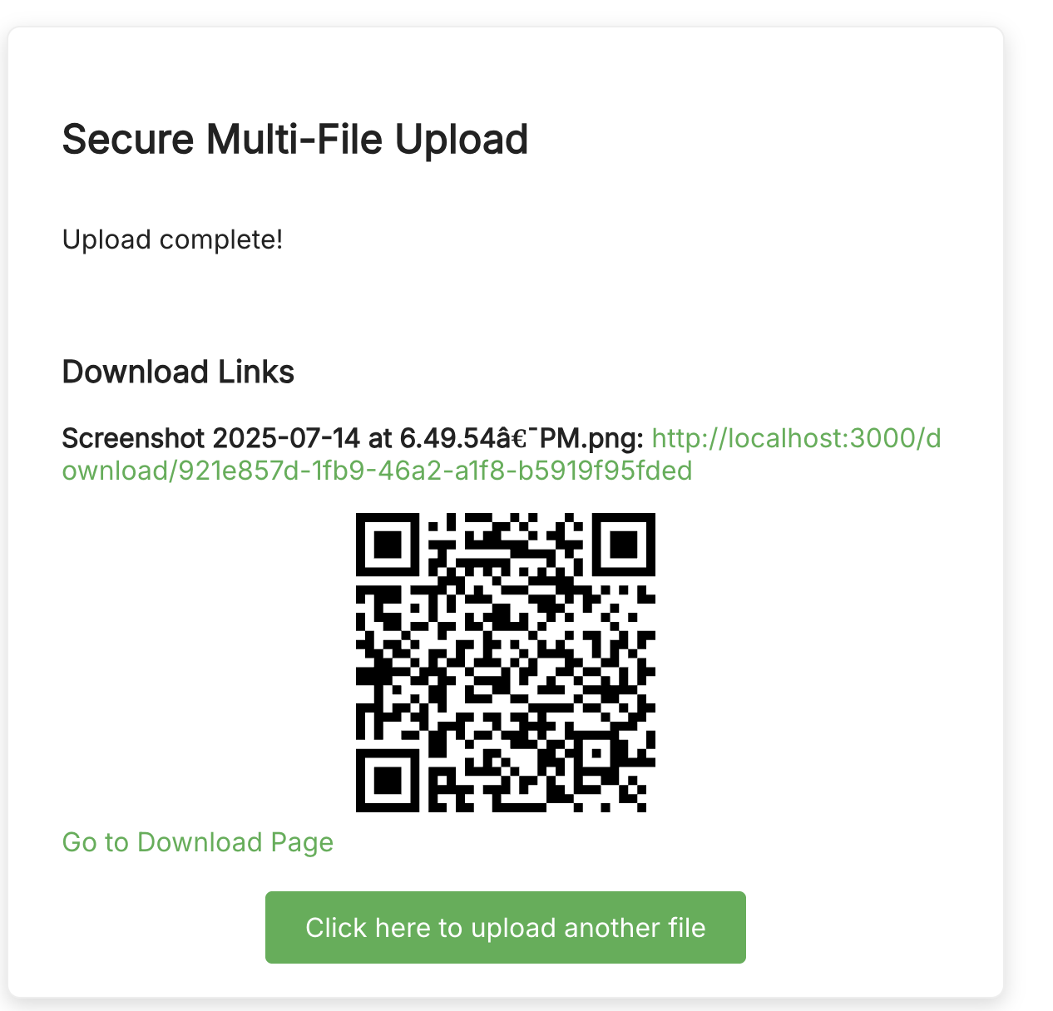
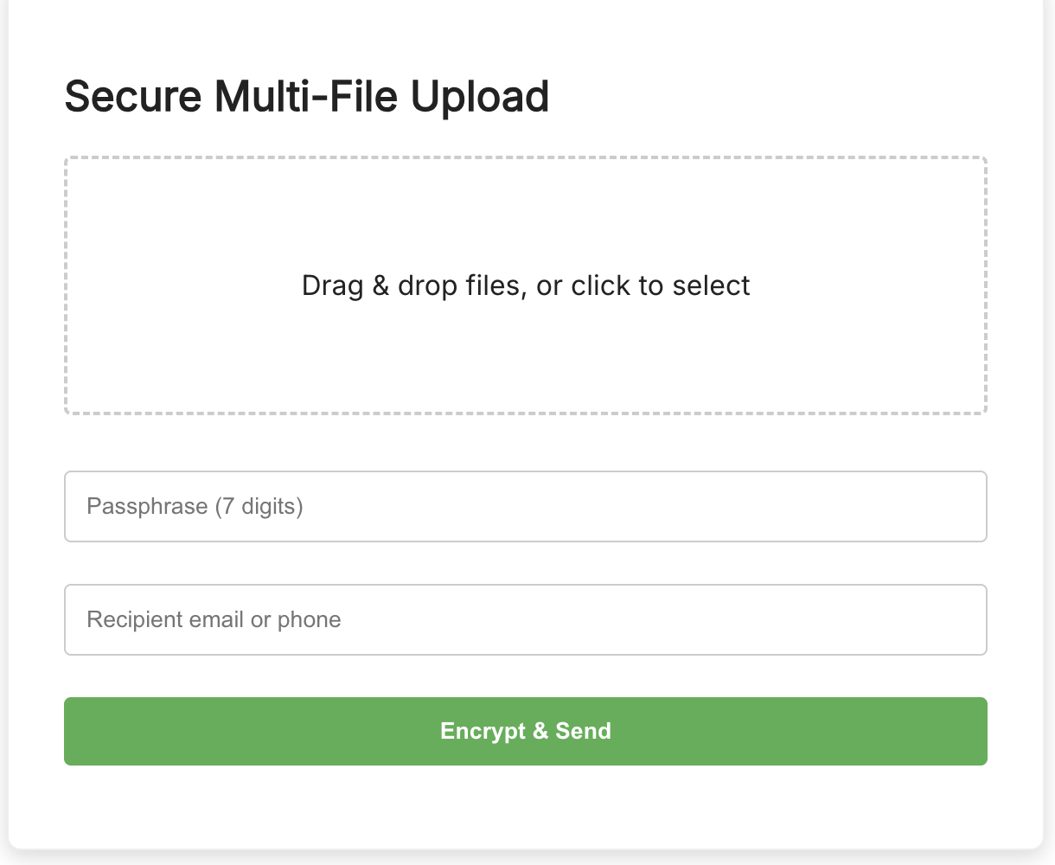
Uploading Page

Slide 16
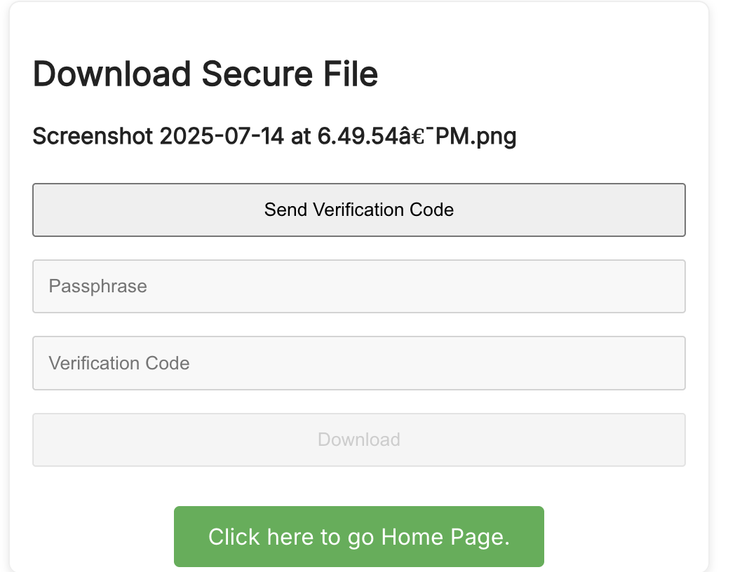
Download Page

Slide 17
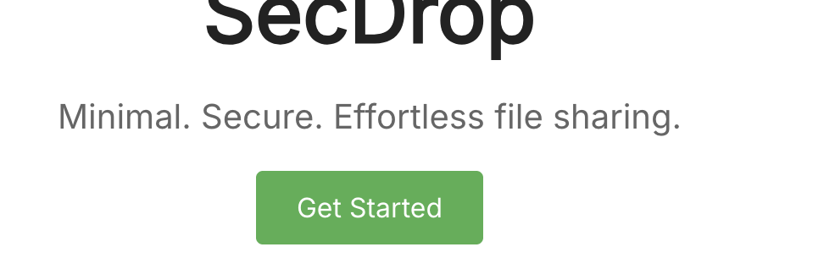
Thank you

